Slide 1
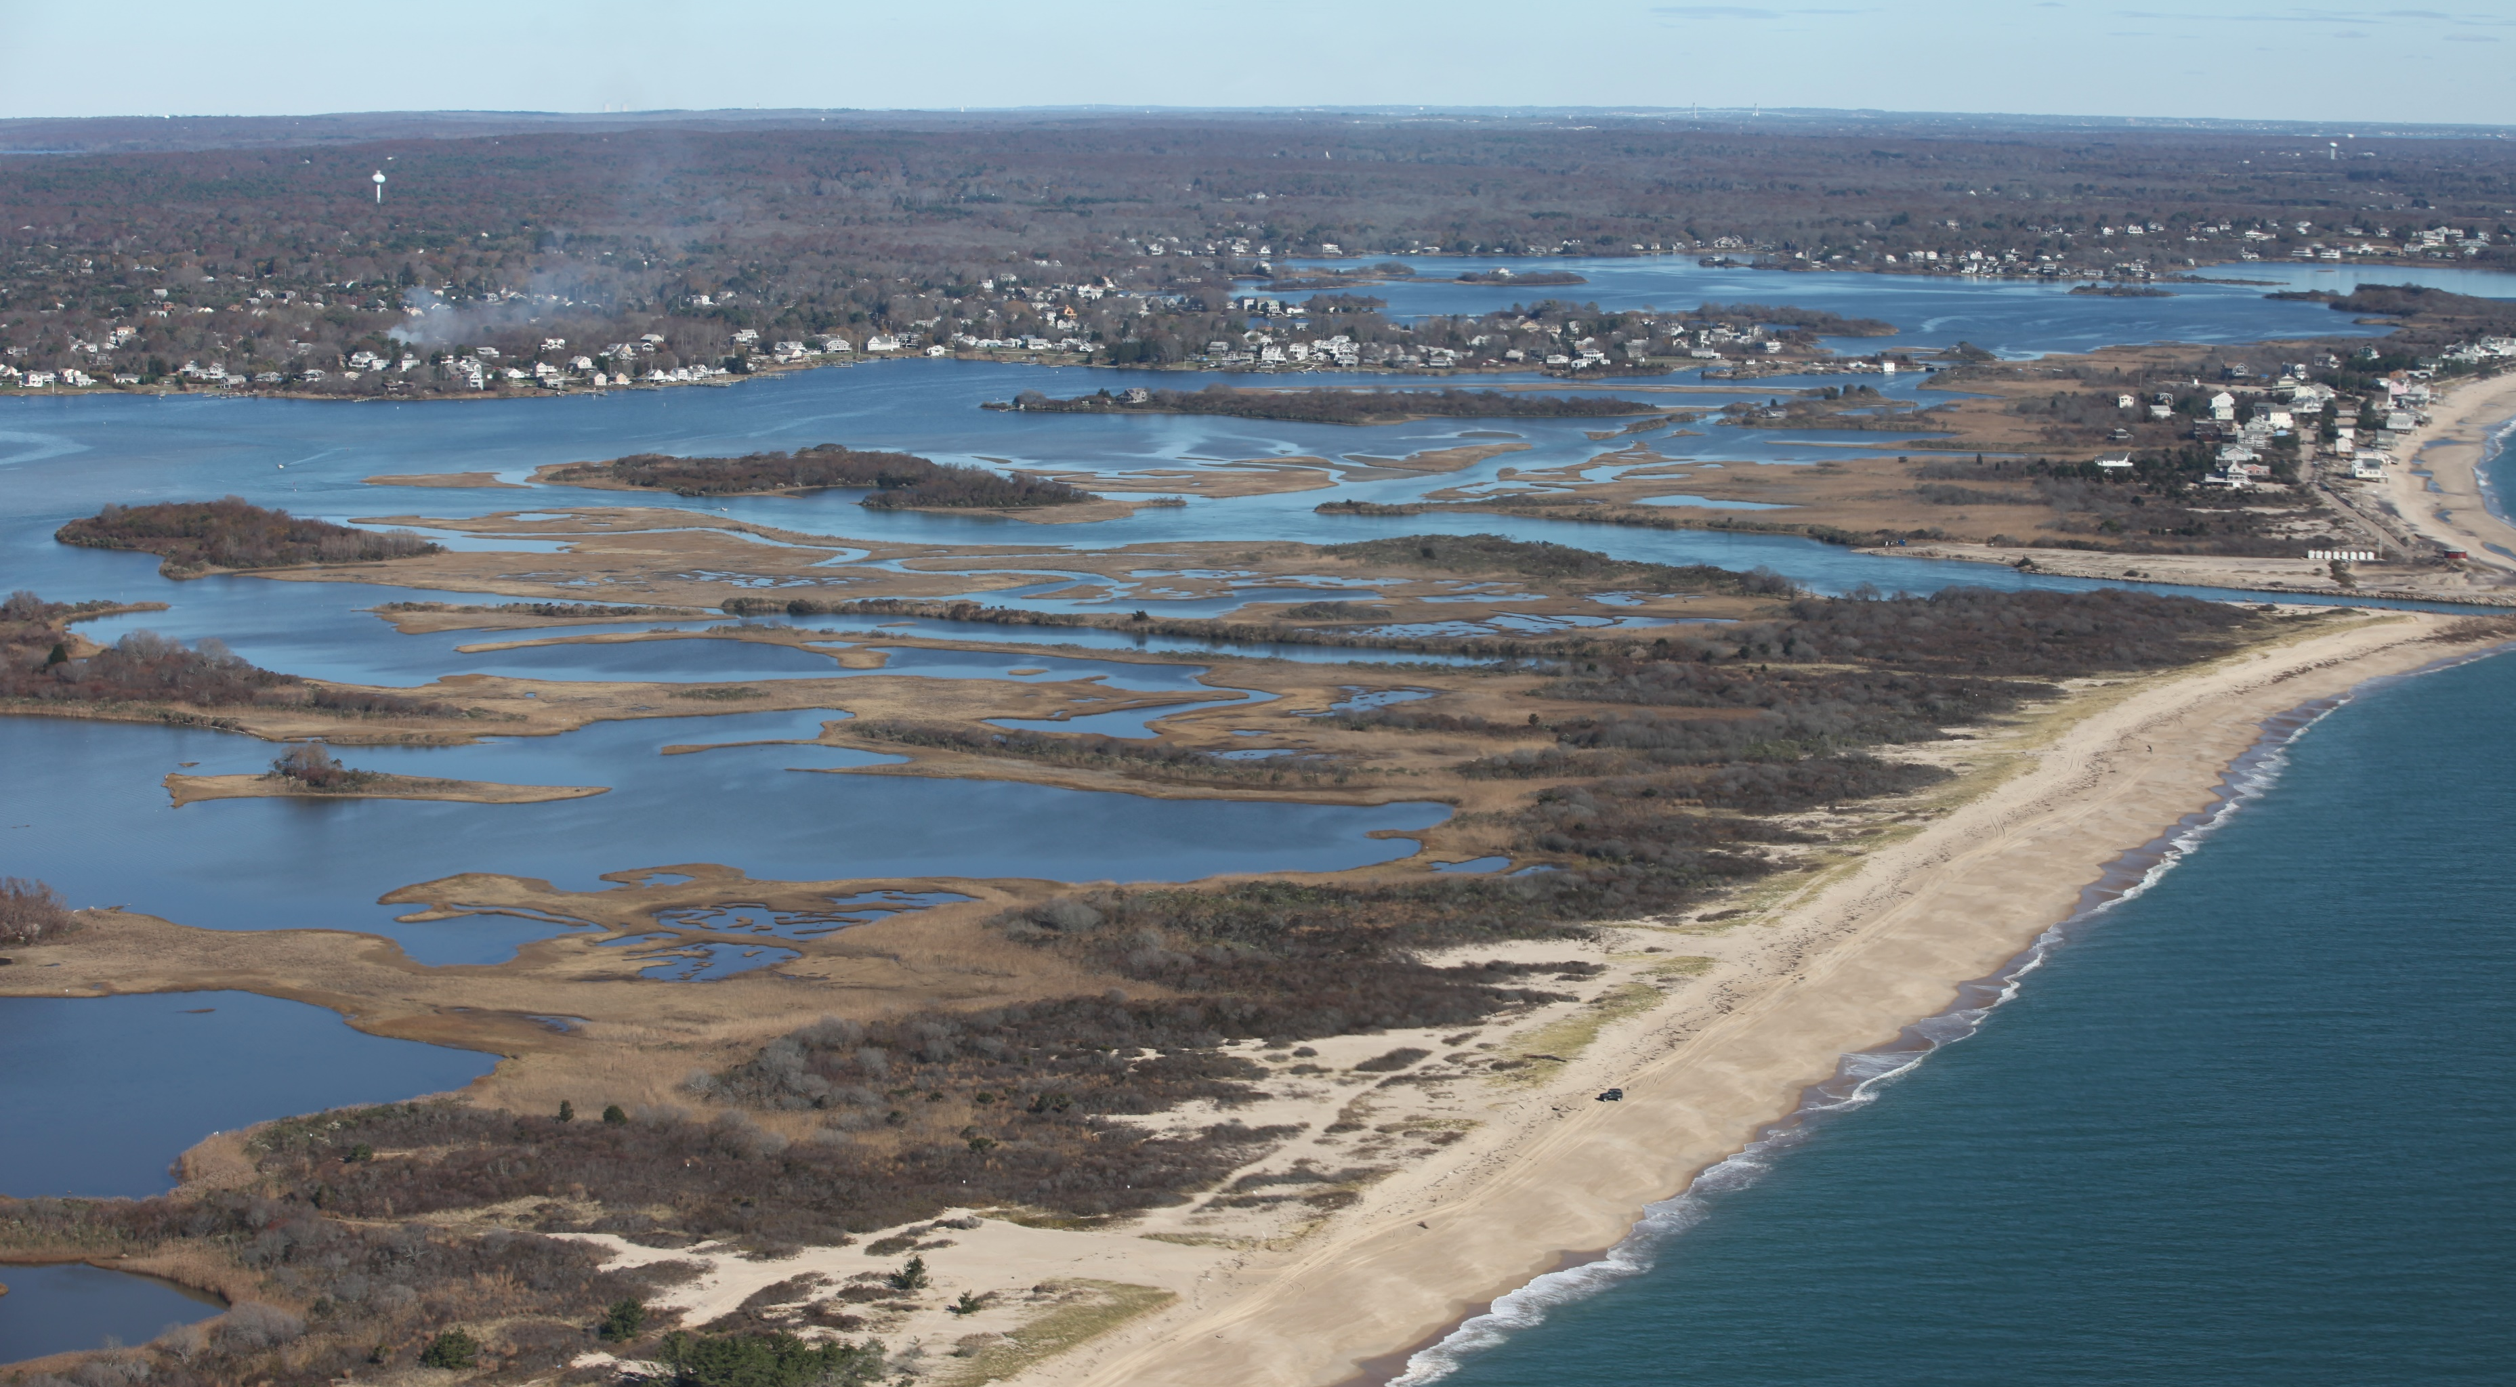
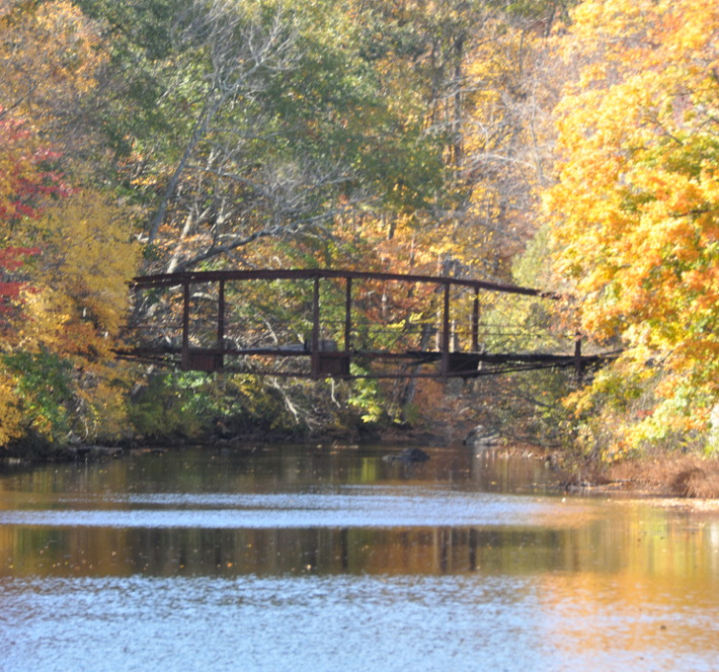
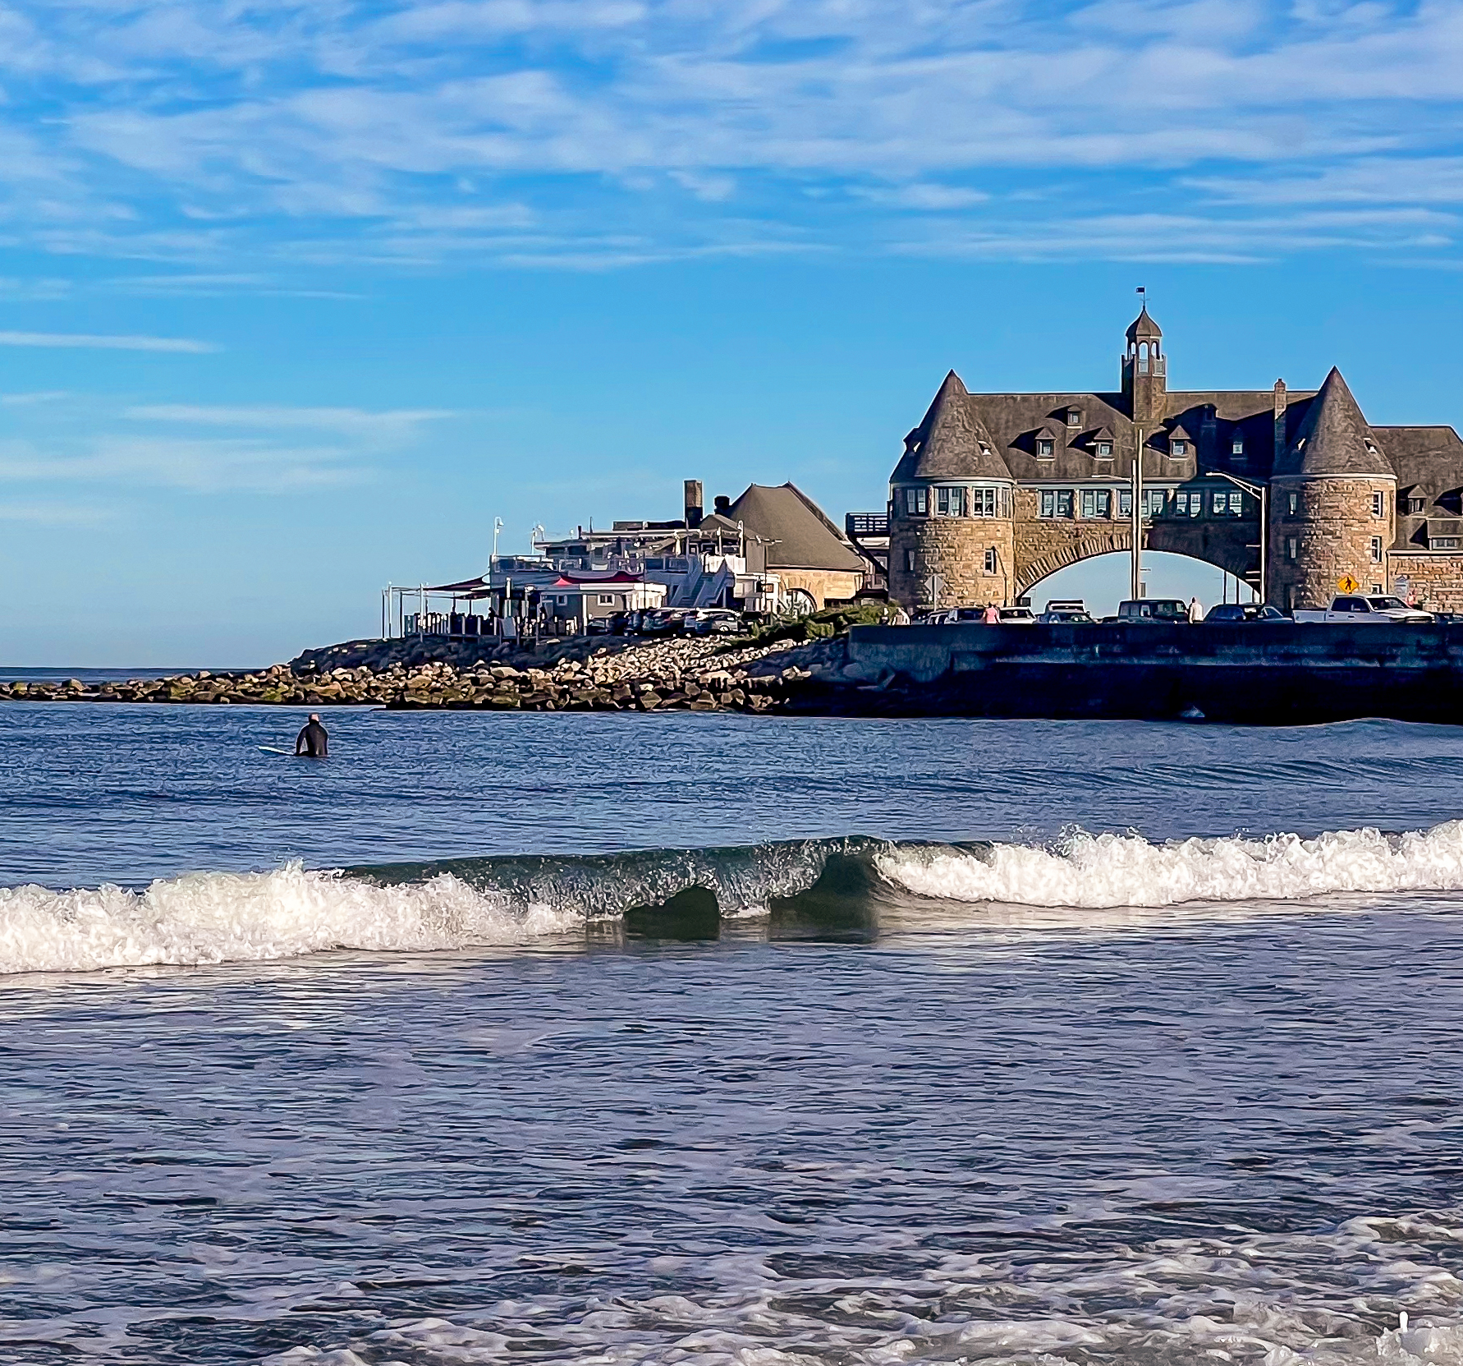
u.S. Army Corps of engineers new England district
- nationwide permit program
Photo credit: Greg Thompson/USFWS
https://www.flickr.com/photos/usfwsnortheast/8158466019
New England District
Rhode Island
July 14, 2025
https://commons.wikimedia.org/wiki/File:CoventryRI_InterlakenMillBridge.jpg
https://commons.wikimedia.org/wiki/File:Narragansett,_Rhode_Island_%2853845090729%29.jpg
Notes:
Introduction

Slide 2
Outreach Events Schedule
Schedule:​
Rhode Island - July 14 (Monday): Where: Rhode Island Department of Administration, One Capitol Hill, Providence, Rhode Island; Time: 10:00am – 12:00pm​
New Hampshire - July 15 (Tuesday): Where: New Hampshire Department of Environmental Services Auditorium, 29 Hazen Drive, Concord, New Hampshire; Time: 9:00am – 11:00am​
Vermont - July 16 (Wednesday): Where: Vermont Agency of Transportation Dill Building, 2178 Airport Road, Berlin, Vermont; Time: 12:30pm – 2:30pm​
Maine - July 17 (Thursday): Where: Le Club Calumet, 334 West River Road, Augusta, Maine; Time: 9:00am – 11:00am​
Connecticut - July 18 (Friday): Where: Connecticut Department of Energy and Environmental Protection Auditorium, 79 Elm Street, Hartford, Connecticut; Time: 9:30am – 11:30am​
Massachusetts - July 24 (Thursday): Where: Massachusetts Department of Transportation Highway District 3 Office, 499 Plantation Parkway, Worcester, Massachusetts; Time: 10:00am – 12:00pm​

Slide 3
Agenda / topics
Regulatory Program Overview
  Authorities and Permit Types
Nationwide Permit Overview
  New England District’s Use
  USACE Headquarters Role
  Districts Role
Conditions
  General Conditions
  Regional Conditions
Water Quality Certification
Coastal Zone Consistency Determination
Comparison of State Regional General Permits and Nationwide Permits
Application Process
  Regulatory Request System
  Complete Preconstruction Notifications
  Endangered Species and Historic Properties
Questions and Answers Session
Corps staff will be available after the meeting for further discussion!

Slide 4
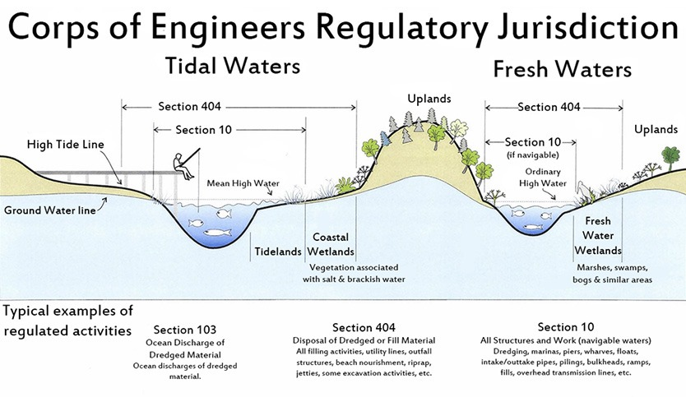
Usace regulatory authorities
Section 10 of the Rivers and Harbors Act of 1899 (RHA)
  Structures and/or work in or affecting navigable waters of the U.S.
Section 404 of the Clean Water Act (CWA)
  Discharges of dredged or fill material into waters of the U.S., including wetlands
Notes:
Before we get into discussing the Nationwide Permits, it’s good to have some background into what our Regulatory jurisdiction is. The Corps has authority to authorize structures and/or work in or affecting navigable waters under Sec. 10 of the RHA. And the Corps also has authority to authorize the discharges of dredged or fill material under Sec. 404 of the CWA. These two authorities are the authorities applicable to the Nationwide Permit program.
Potentially mention Sec. 9 of the RHA and Sec. 103 of the Marine Protection Research and Sanctuaries Act, but state that none of the NWPs operate under these authorities.

Slide 5
Department of the Army (DA) Permit types
General Permits (GP)
Authorize similar activity types
Nationwide Permits (NWPs) – Issued by regulation by Corps Headquarters
Individual Permits (IP)
Authorize activities which don’t fit a GP
Letters of Permission (LOP)
Standard Permits (SP)
Regional General Permits (RGPs) – Issued by a division or district engineer
Programmatic General Permits (PGPs) – Issued by a division or district engineer and founded on existing state, local, or other Federal program
District Issues
District Verifies
Notes:
Under the Corps’ authorities we issue Department of the Army (abbreviated “DA”) Permits. The Corps has several types of permits categorized into two groups: General Permits (GPs) and Individual Permits (IPs).
General Permits are permits that are issued for similar types of activities. You are likely familiar with Regional General Permits or RGPs, as these are what we’ve been using in New England District for many, many years now. Regional General Permits are issued by a district or division for similar types of activities and only apply within a specific geographic region. Regional General Permits are typically used as a means to efficiently review activities that have minimal impacts, and in districts that use the Nationwide Permits, Regional General Permits are typically used to authorize similar types of activities that are minimal but don’t fit any of those Nationwide Permits.
Programmatic General Permits are essentially Regional General Permits in that they are issued by a district or division and apply within a specific geographic region, but they are founded on an existing state, local, or other Federal program. The aim of Programmatic General Permits is to reduce duplicative review of proposed activities.
Nationwide Permits or NWPs are issued by our Corps headquarters every five years, again, for similar type activities. And these are what we are here to talk about today!
Individual Permits are for those proposed activities which don’t fit an existing general permit. We won’t talk about these today, but if you want to learn more about individual permits, come talk to us afterwards or give us a call.
You’ll hear us use the words “verify” or “verification” in this presentation and I want to take a moment to explain what that means. Because General Permits are permits which are already issued, when we receive a preconstruction notification for proposed activities, we evaluate it and “verify” that the activities fit the terms and conditions of the General Permit. We then send the permittee a “verification” letter stating such. We don’t issue General Permits for individually proposed activities. We do issue Individual Permits for individually proposed activities.

Slide 6
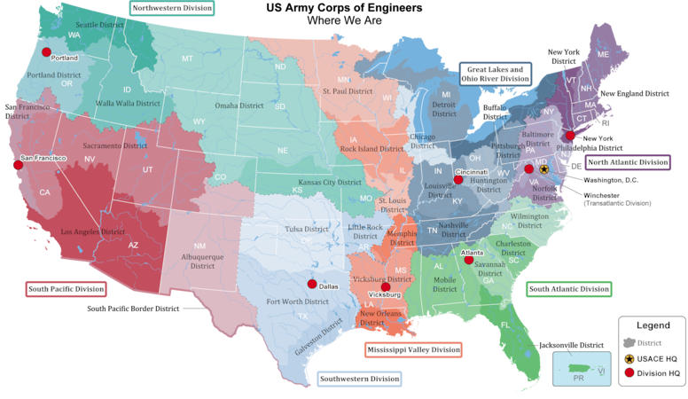
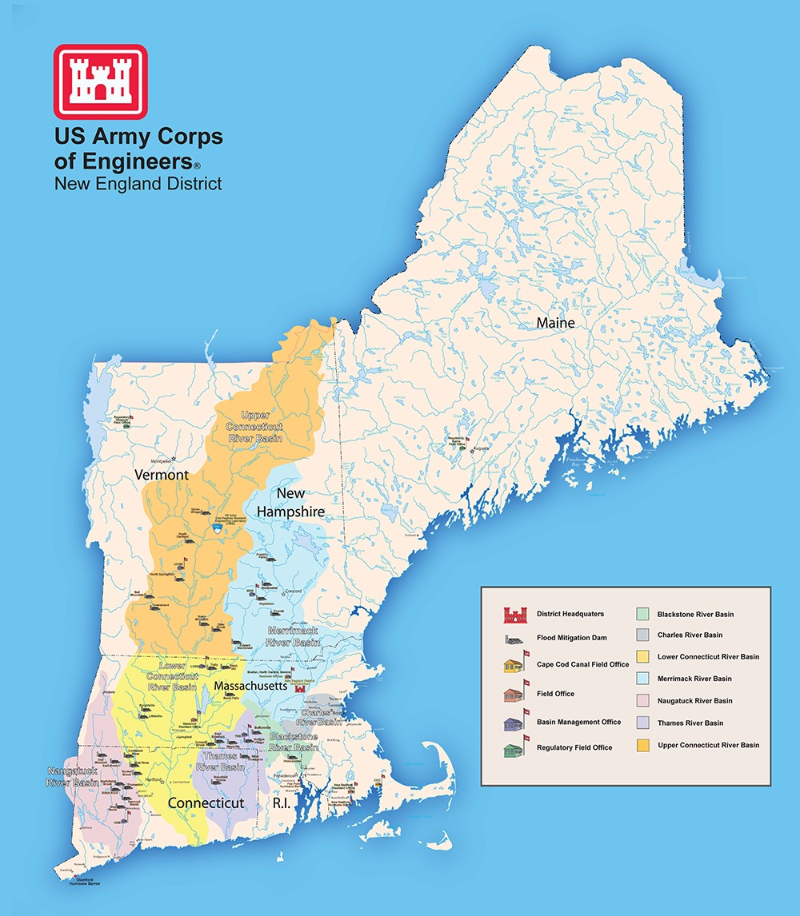
Use of nationwide permits in new England
Nationwide Permit (NWP)
Regional General Permit (RGP)
Type of general permits issued by USACE Headquarters
Used to authorize activities across the country
Districts add regional conditions
Certain minor activities are generally non-reporting
Type of general permit issued at the division/district level
Usually used in conjunction with NWP to meet regional needs
Specific RGPs can supplement specific NWPs
Current New England District’s RGPs were largely modeled after the NWPs
NWPs will replace many, but not all RGPs
Notes:
The Corps New England District is transitioning to the use of Nationwide Permits. We’re doing this for a few reasons:
- Transitioning to the use of Nationwide Permits will better align the district’s implementation of the Regulatory Program with the rest of the nation.
- As we’ve said before, our headquarters issues these permits – not us at the district. This means we will no longer have packages of Regional General Permits to reissue. Reissuance of state Regional General Permit packages is a huge undertaking, and we do it quite often because each package of state Regional General Permits have different expiration dates. The intent is, if we take that effort off our plates – it gives our project managers more time and space to focus on permit application reviews.
- Also, utilizing the Nationwide Permits will allow for better predictability and consistency for the regulated public. Many consultants may work in different states or even different districts. If we offer the same permitting tools as the next state or the next district, it should be easier for consultants to help navigate the Regulatory Program for their clients.
And although it seems like a big change and in some ways is, the transition to the Nationwide Permits will not be completely foreign, as our current state Regional General Permits were largely modeled after the Nationwide Permits. We’ll get into the differences and similarities a bit later in our presentation. We’ll also discuss later in the presentation that the Nationwide Permits will replace many, but they won’t replace all of our Regional General Permits, because we do have some pretty great Regional General Permits.

Slide 7
Nationwide permit timeline
Discussions with New England States (401/CZM)
Develop draft Regional Conditions to the NWPs
USACE HQ publishes proposed NWPs in Federal Register
Ongoing Collaboration
Public Comment Period
District publishes Public Notice proposing regional conditions
District completes review of NWP Regional Conditions
District implements NWPs
We are here
Public Comment Period
Review of Public Notice comments
Finalization of Regional Conditions
March 2026
Notes:
Okay, so timeline: Our implementation of the Nationwide Permit program is scheduled to occur with the issuance of the 2026 Nationwide Permits in mid-March of 2026. In preparation, we’ve been meeting regularly since the beginning of this year with our state agencies and have been developing draft Regional Conditions to the Nationwide Permits (which we will get into more detail about a little bit later in the presentation).
Those yellow stars indicate where we are in the process: our headquarters published the proposed 2026 Nationwide Permits in the Federal Register and our district has issued a public notice about the Nationwide Permits and our proposed Regional Conditions. Again, we’ll talk about those both in the coming slides, but after those comment periods end, our district will be reviewing the comments we receive, finalizing our Regional Conditions, and completing supplemental documentation to our headquarters’ decision to issue the Nationwide Permits.

Slide 8
Agency roles in the nationwide permit program
USACE Headquarters
Nationwide Permit
Issued by Corps Headquarters via Federal rule making
General Conditions
Issued by Corps Headquarters with the Nationwide Permits
USACE Districts
Regional Conditions
Developed and issued by Districts
Verification
Districts verify proposed activities fit the terms of the NWP
Special Conditions
Applied to verifications on a case-by-case basis
State Agency Partners
Water Quality Certification Conditions
Developed by the State Certifying Authority
Coastal Zone Management Conditions
Developed by the State Coastal Zone Management Program Office
Notes:
We thought it would be helpful to illustrate the role our headquarters, the district, and our state agency partners have in the Nationwide Permit program.
As previously said, our headquarters issues the Nationwide Permits every five years via a Federal rule making. So, every five years, they reissue the Nationwide Permits with any proposed changes. Along with the Nationwide Permits, they also develop and issue General Conditions to the Nationwide Permits.
At the district level, we don’t issue the Nationwide Permits, but we verify proposed activities under those Nationwide Permits. And, during our headquarters’ reissuance efforts, the districts develop and issue Regional Conditions to the Nationwide Permits. The General Conditions to the Nationwide Permits are quite general because they have to apply nationwide. Developing Regional Conditions allows districts to ensure minimal impact to the aquatic resources of particular importance in their geographic region. Districts also have the ability to add Special Conditions on a case-by-case, activity-specific basis to verifications of activities authorized by a Nationwide Permit. These are developed while a project manager is evaluating a proposed project.
Our state agency partners review the Nationwide Permits, with the General Conditions, and our proposed Regional Conditions under their Clean Water Act Section 401 (that is the Water Quality Certification) and Coastal Zone Management Act authorities. If the agencies choose issue a Water Quality Certification and concur with our consistency determination, they can add conditions to their certification and concurrence, and those conditions will also apply to the Nationwide Permits.

Slide 9
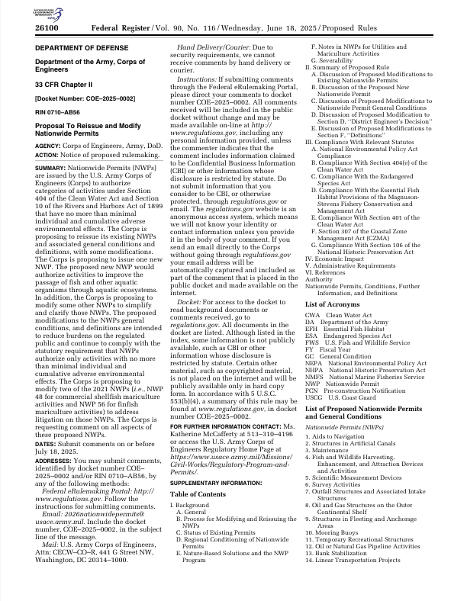
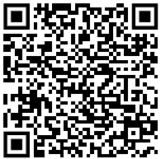
Nationwide permits
Issued every five years by USACE Headquarters
Proposed 2026 Nationwide Permits published in the Federal Register on June 18, 2025
Comment period through July 18, 2025
https://www.federalregister.gov/documents/2025/06/18/2025-11190/proposal-to-reissue-and-modify-nationwide-permits
Notes:
Our headquarters issues the Nationwide Permits every five years. The proposed 2026 Nationwide Permits were published in the Federal Register on June 18. Comments on the proposed Nationwide Permits are being accepted until July 18. If you want to make comments on the Nationwide Permits and/or their General Conditions, you can do so through the Federal Register. Again, our headquarters developments and finalizes the Nationwide Permits and their General Conditions, so the best way to comment on the permits and their conditions is directly to our Headquarters through the Federal Register.

Slide 10
Nationwide Permits
30. Moist Soil Management for Wildlife
31. Maintenance of Existing Flood Control Facilities
32. Completed Enforcement Actions
33. Temporary Construction, Access, and Dewatering
34. Cranberry Production Activities
35. Maintenance Dredging of Existing Basins
36. Boat Ramps
37. Emergency Watershed Protection and Rehabilitation
38. Cleanup of Hazardous and Toxic Waste
39. Commercial and Institutional Developments
40. Agricultural Activities
41. Reshaping Existing Drainage and Irrigation Ditches
42. Recreational Facilities
43. Stormwater Management Facilities
44. Mining Activities
45. Repair of Uplands Damaged by Discrete Events
46. Discharges in Ditches
48. Commercial Shellfish Mariculture Activities
49. Coal Remining Activities
50. Underground Coal Mining Activities
51. Land-Based Renewable Energy Generation Facilities
52. Water-Based Renewable Energy
53. Removal of Low-Head Dams
54. Living Shorelines
55. Seaweed Mariculture Activities
56. Finfish Mariculture Activities [Revoked nationwide]
57. Electric Utility Line and Telecommunications Activities
58. Utility Line Activities for Water and Other Substances
59. Water Reclamation and Reuse Facilities
A. Activities to Improve Passage of Fish and Other Aquatic Organisms
Aids to Navigation
Structures in Artificial Canals (RGP)
Maintenance
Fish and Wildlife Harvesting, Enhancement, and Attraction Devices and Activities
Scientific Measurement Devices
Survey Activities
Outfall Structures and Associated Intake Structures
Oil and Gas Structures on the Outer Continental Shelf
Structures in Fleeting and Anchorage Areas
Mooring Buoys
Temporary Recreational Structures
Oil or Natural Gas Pipeline Activities
Bank Stabilization
Linear Transportation Projects
U.S. Coast Guard Approved Bridges
Return Water from Upland Contained Disposal Areas
Hydropower Projects
Minor Discharges
Minor Dredging
Response Operations for Oil or Hazardous Substances
Surface Coal Mining Activities
Removal of Vessels
Approved Categorical Exclusions
Indian Tribe or State Administered Section 404 Programs
Structural Discharges (RGP)
27. Aquatic Habitat Restoration, Enhancement, and Establishment Activities
28. Modifications of Existing Marinas
29. Residential Developments
Notes:
Apologies for this tiny text, but this is a list of the proposed 2026 Nationwide Permits. There is only one new Nationwide Permit proposed – the one in green: A, Activities to Improve Passage of Fish and Other Aquatic Organisms. If this proposed Nationwide Permit is issued, it will be given a number.
The Nationwide Permits shown in red are ones we do not propose to implement in New England. Some activities authorized by these Nationwide Permits would be authorized by our Regional General Permits, and other activities we do not anticipate receiving preconstruction notifications for.

Slide 11
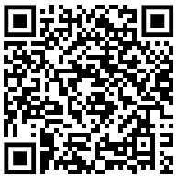
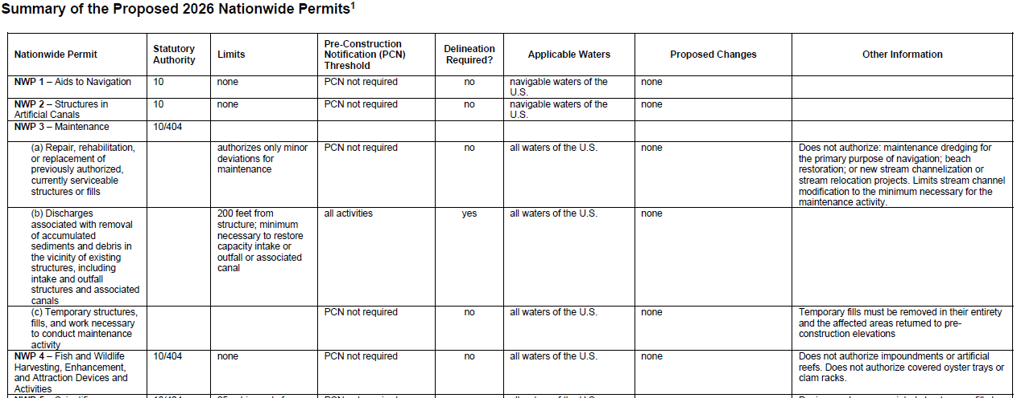
Nationwide Permits
https://www.usace.army.mil/Missions/Civil-Works/Regulatory-Program-and-Permits/Nationwide-Permits/
Notes:
This here is summary chart that our headquarters publishes with the Nationwide Permits. What’s on the screen here is just a portion of the first page, but the entire chart can be found on our headquarters’ website. This is a super helpful chart that allows you to get an understanding of each permit quickly. It’s especially helpful when you are trying to determine which Nationwide Permit may fit a project you have in mind. You can use it to narrow down the permits you want to look at, and then you can go to that specific permit and read in more detail exactly what it authorizes and all of its terms and conditions.
The chart also has a great column, “Proposed Changes.” If you are already familiar with the Nationwide Permits and are curious about what’s being proposed to change, but don’t want to read the long Federal Register notice, this would be a good resource to consult.

Slide 12
Nationwide permits general conditions
Navigation
Aquatic Life Movements
Spawning Areas
Migratory Bird Breeding Areas
Shellfish Beds
Suitable Material
Water Supply Intakes
Adverse Effects from Impoundments
Management of Water Flows
Fills within 100-Year Floodplains
Equipment
Soil Erosion and Sediment Controls
Removal of Temporary Structures and Fills
Proper Maintenance
Single and Complete Project
Wild and Scenic Rivers
Tribal Rights
Endangered Species
Migratory Birds and Bald and Golden Eagles
Historic Properties
Discovery of Previously Unknown Remains and Artifacts
Designated Critical Resource Waters
Mitigation
Safety of Impoundment Structures
Water Quality
Coastal Zone Management
Regional and Case-By-Case Conditions
Use of Multiple Nationwide Permits
Transfer of Nationwide Permit Verifications
Compliance Certification
Activities Affecting Structures or Works Built by the United States
Pre-Construction Notification
Notes:
These are the 32 General Conditions that our headquarters issues to the Nationwide Permits. All activities which are authorized by a Nationwide Permit must comply with all applicable General Conditions.
General Condition 27 is in green, because that’s the conditions which explains that special conditions can be added to verifications as needed and that districts can add Regional Conditions to the Nationwide Permits.

Slide 13
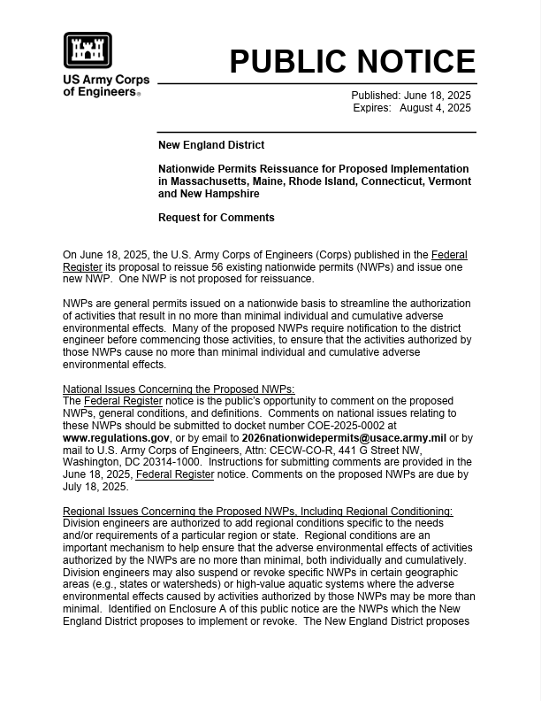

Regional Conditions
New England District’s proposed Regional Conditions to the 2026 Nationwide Permits were published via public notice on June 18
https://www.nae.usace.army.mil/Missions/Regulatory/PublicNotices/Article/4221092/nationwide-permits-reissuance-for-proposed-implementation-in-massachusetts-main/
We are accepting comments on the proposed Regional Conditions until August 4 (CENAE-R-NWP@usace.army.mil)
Notes:
New England District issued a public notice on June 18th with our proposed Regional Conditions. We would love to receive your comments on them. The comment period is 45 days and ends on August 4.
Just a note here to say that if you submitted comments prior to July 3 to the email address in the public notice – if you copied and pasted the email address into your email “To” line, your comments didn’t reach us. Although the email address was correct in the public notice, it was split between two lines which prevented it from being copied and pasted correctly. The public notice has been edited so the address in on one line and copies and pastes correctly now. So, if you submitted comments prior to July 3, please resend those.

Slide 14
Regional conditions
Goals:
  Not repetitive of the Nationwide Permit General Conditions
  Ensure a continued level of evaluation of projects as occurring under the Regional General Permits
  Enable our certifying authorities to certify the Nationwide Permits under Section 401 of the Clean Water Act
  Enable our coastal programs to determine the Nationwide Permits consistent under the Coastal Zone Management Act
Notes:
As you are reviewing our proposed Regional Conditions, we’d like you to keep in mind what our goals with those conditions are. When we drafted our proposed Regional Conditions, we started with the states’ Regional General Permits and compared the conditions within those to the General Conditions of the current Nationwide Permits.
These were our main goals. List goals on slide
As you review our proposed Regional Conditions, if you find that it looks like we left a condition out, it may be that a similar condition already exists in the Nationwide Permit General Conditions. In these cases, our plan is to provide specificity on how to comply with that General Condition in New England through a note to that General Condition.

Slide 15
General condition notes example:
12. Soil Erosion and Sediment Controls
Appropriate soil erosion and sediment controls must be used and maintained in effective operating condition during construction, and all exposed soil and other fills, as well as any work below the ordinary high water mark or high tide line, must be permanently stabilized at the earliest practicable date. Permittees are encouraged to perform work within waters of the United States during periods of low-flow or no-flow, or during low tides.
NAE Note: Compliance with this condition may be achieved by ensuring that all discharge points back into waters of the U.S., including wetlands use appropriate energy dissipaters and erosion and sedimentation control BMPs. Controls that are biodegradable can be left in place, but should be removed if they are not biodegradable. Temporary controls should be removed upon completion of work, but not before all exposed soil and other fills and any work waterward of the OHWM are permanently stabilized. Once permanently stabilized, temporary controls should be removed as soon as possible. Sediment and debris collected by these controls should be removed and placed at an upland location and in a manner that will prevent its later erosion into a waterway or wetland.
Notes:
For example: This is General Condition 12 of the Nationwide Permits. Once we implement the Nationwide Permits, we’d published on our website the General Conditions with notes as needed, like this, that specify how compliance with the condition may be achieved. So, although we aren’t proposing to include a Regional Condition about soil erosion and sediment controls, such actions are still required, and additional specificity will still be given.

Slide 16
Clean water act sec. 401 water quality certification
Every DA permit application proposing a discharge of fill or dredged material requires review under Section 401 of the CWA by a Certifying Authority (CA)
Nationwide Permits that would authorize discharges of fill or dredged material also require this review
Four Potential Outcomes:
CA Waives Water Quality Certification (WQC)
NWP can authorize projects without further Sec. 401 review.
CA Issues a WQC without Conditions
NWP can authorize projects without further Sec. 401 review.
CA Issues a WQC with Conditions
NWP can authorize projects without further Sec. 401 review. Permittee must follow all applicable WQC conditions.
CA Denies WQC
NWP cannot authorize projects until applicants obtain an individual WQC for their specific project from the CA.
Notes:
Okay, shifting gears a little bit to the Clean Water Act Section 401 Water Quality Certifications.
In order for the Corps to issue a permit for the discharge of fill or dredged material, the project must first be reviewed by the appropriate certifying authority under Section 401 for the potential issuance of a Water Quality Certification. The Nationwide Permits are no different. Our district has requested Water Quality Certification for the Nationwide Permits from all of the certifying authorities in New England – that is from the states and the Environmental Protection Agency.
There are four potential outcomes of the review of the Nationwide Permits under Section 401:
First, the certifying authorities may waive Water Quality Certification for some or all the Nationwide Permits. In this case, those Nationwide Permits for which Water Quality Certification is waived can authorize projects without further Section 401 review.
Second, the certifying authorities may issue Water Quality Certification for some or all of the Nationwide Permits WITHOUT conditions. In this case, those Nationwide Permits for which Water Quality Certification has been issued can authorize projects without further Section 401 review.
Third, the certifying authorities may issue Water Quality Certification for some or all of the Nationwide Permits WITH conditions. In this case, those Nationwide Permits for which Water Quality Certification has been issued with conditions can authorize projects without further Section 401 review, but the permittee MUST follow all applicable Water Quality Certification conditions.
And lastly, the certifying authorities may deny Water Quality Certification for some or all of the Nationwide Permits. In this case, those Nationwide Permits for which Water Quality Certification is denied cannot authorize projects until the individual applicant obtains a project-specific, individual Water Quality Certification for their project. To be clear, the Corps can still utilize the Nationwide Permit, but the applicant won’t be authorized to do the work until that project-specific, individual Water Quality Certification is obtained.

Slide 17
Coastal zone management act consistency determination
Every DA permit application proposing a project within a state’s Coastal Zone requires review under Section 307(c) of the Coastal Zone Management Act (CZMA)
  A state’s Coastal Zone Management Program Office reviews a project proponent’s determination that their project is consistent with the state’s coastal zone management program
Nationwide Permits that would authorize projects within a state’s Coastal Zone also require this review
Three Potential Outcomes:
State Disagrees with Consistency Determination
NWP cannot authorize projects until applicant completes and receives concurrence on an individual consistency determination specific to their project.
State Conditionally Concurs with Consistency Determination
NWP can authorize projects without further CZMA review. Permittee must follow all applicable CZM conditions.
State Concurs with Consistency Determination
NWP can authorize projects without further CZMA review.
Notes:
Similar to the Clean Water Act Section 401, in order for the Corps to issue a permit for projects located within a state’s Coastal Zone, the project must first be reviewed by the appropriate state office for consistency with that state’s Coastal Zone Management Program. The Nationwide Permits are no different. Our district has requested concurrence with our consistency determination for the Nationwide Permits from all Coastal Zone Management Programs in New England.
There are three potential outcomes of the review of the Nationwide Permits under the CZMA:
First, the state may concur with our consistency determination for some or all the Nationwide Permits. In this case, those Nationwide Permits which were concurred upon can authorize projects without further CZMA review.
Second, the state may concur with our consistency determination for some or all of the Nationwide Permits WITH conditions. In this case, those Nationwide Permits which were conditionally concurred upon can authorize projects without further CZMA review, but the permittee MUST follow all applicable Coastal Zone Management Program conditions.
And lastly, the state may disagree or object with our consistency determination for some or all of the Nationwide Permits. In this case, those Nationwide Permits which were not concurred upon cannot authorize projects until the individual applicant obtains a project-specific, Coastal Zone Management Program consistency determination concurrence for their project. To be clear, the Corps can still utilize the Nationwide Permit, but the applicant won’t be authorized to do the work until that project-specific, individual Coastal Zone Management Program consistency determination concurrence is obtained.

Slide 18

Nationwide permit activities
Activities authorized by NWPs must:
  Fit the terms of the NWP
  Follow all applicable General Conditions
  Follow all applicable Regional Conditions
  Follow all project-specific Special Conditions
  Follow all applicable WQC conditions
  Be consistent with the state’s Coastal Zone Management Program and follow all applicable conditions of concurrence
Authorization of activities authorized by NWPs does not obviate the need to obtain other federal, state, or local authorizations
Notes:
So any activity authorized by a Nationwide Permit must:
Fit the terms of the permit itself,
Follow all appliable General Conditions, Regional Conditions, Special Conditions, Water Quality Certification Conditions, be consistent with the state’s Coastal Zone Management Program and follow any conditions of concurrence.
The Nationwide Permits function just like our Regional General Permits, in this respect.
And, of course, authorization of activities under a Nationwide Permit doesn’t obviate the need for applicants/permittees to obtain other necessary authorizations.

Slide 19
Regional general permits
The Nationwide Permits will replace many of the states’ Regional General Permits, but not all!
Verifications under the current Regional General Permits remain valid until the expiration of the permit, or one year from the date of expiration if the project has commenced or is under contract.
After Nationwide Permit issuance, we will select which Regional General Permits in each state remain available for use.
As selected state Regional General Permits near their expiration dates, we will evaluate them for potential reissuance.
Sunset?
Reissue for state only?
Reissue New England-wide?
Notes:
The Nationwide Permits don’t cover all of the activities our current Regional General Permits cover, or it may be the case that certain Regional General Permits are more efficient than the Nationwide Permits, so not all Regional General Permits will be replaced. After the Nationwide Permits go into effect, we will publish which Regional General Permits remain available for use. It’s important to note that permittees that have received a verification under their state’s Regional General Permits will not have to obtain a new Nationwide Permit verification. Verifications of the Regional General Permits remain valid until expiration or one year after expiration if the project has commenced or is under contract to commence.
Then, as the Regional General Permits which remain available for use approach their expiration date, we will evaluate those for potential reissuance. Depending on use, we may allow a Regional General Permit to sunset. Or we may reissue it for just the state or maybe we’ll determine it’s a valuable permit for all of New England and reissue it New England-wide.

Slide 20
New England-wide regional general permits
Boat Ramps
*would cover more than allowable under NWP 36*
Dredging, Disposal of Dredged Material, Beach Nourishment, Rock Relocation, Rock & Debris Removal, and Recreational Beach Grading & Raking
Structures and Moorings in Navigable Waters of the U.S.
Notes:
We have already identified three Regional General Permits that are useful New England-wide, and we are in the process of developing these.
These three Regional General Permits would allow for efficient coverage of many common activities proposed throughout New England.

Slide 21
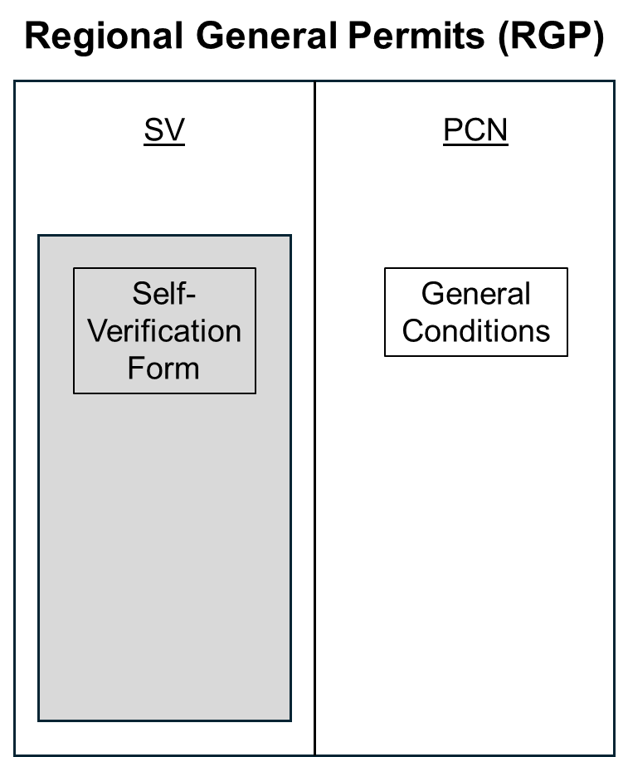
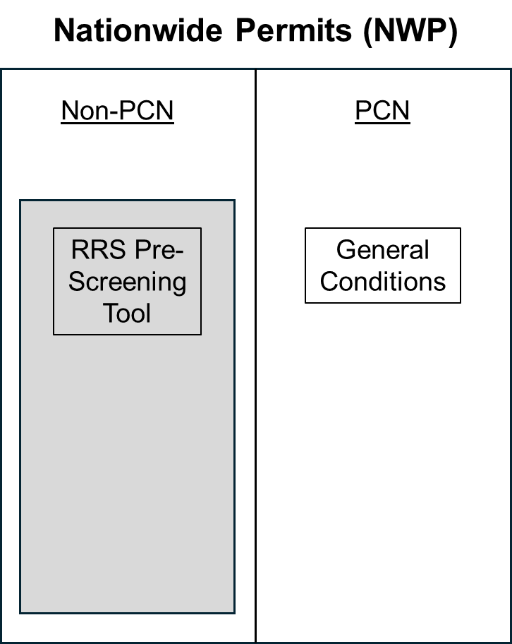

Comparison of NWP and RGP submittal Process
Regional Conditions
Notes:
One of the over-arching differences between the Nationwide Permits and our Regional General Permits has to do with preconstruction notification.
Our Regional General Permits have two categories: Self-Verification or SV and Preconstruction Notification or PCN. The way it works for most state Regional General Permits, if your project qualifies for self-verification, the applicant completes a “Self-Verification Notification Form,” sends it to us, we look it over, and say, “Yes, this qualifies for self-verification,” or “No, this doesn’t qualify, you need to submit a preconstruction notification.”
This process doesn’t exist under the Nationwide Permits. Instead, the Nationwide Permits have the two categories: “Non-PCN,” which we also call “non-notifying” or “non-reporting,” and PCN. Each Nationwide Permit states when a preconstruction notification is required. If it doesn’t explicitly state when a preconstruction notification is required, that means that Nationwide Permit is “non-notifying,” meaning applicants do not need to submit any type of paperwork to the Corps.
Now, there are some caveats to Nationwide Permits that are “non-notifying.” There are some General Conditions which can trigger a PCN, and the District has proposed some Regional Conditions which would also trigger a PCN. If the Nationwide Permit an applicant is considering doesn’t require notification, they still need to look at all General and Regional Conditions to ensure none of those which trigger a PCN would apply to their project.
Currently, it is the responsibility of the applicant to determine if their project fits a non-notifying Nationwide Permit, although we at the Corps are more than happy to guide applicants through that. But, we are very excited to say that at a national level, the Corps is working on tools to assist applicants in making that determination. We’ll get into that more a little bit later in this presentation.
The benefit of not requiring notification for certain project types that typically have very minor impacts is efficiency. Applicants don’t need to apply, then work back and forth with their assigned project manager, and then wait for a verification letter. They can go do their project because it is already authorized. But they are still responsible for complying with all terms and applicable conditions (that’s General, Regional, WQC, and CZM conditions).
This efficiency is also something we’re looking at adopting as we reissue Regional General Permits, as well.
PDT member if they are willing to speak longer

Slide 22
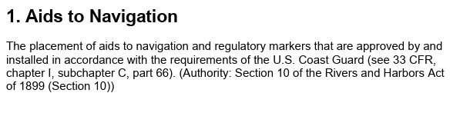
20 Nationwide Permits are non-notifying per their specific language.
Notes:
Let’s go through some examples of Nationwide Permits with different notification requirements. This is Nationwide Permit 1, Aids to Navigation. It’s a super-simple permit, one sentence long. You’ll see that it doesn’t mention notification whatsoever. This is a non-notifying Nationwide Permit.

Slide 23
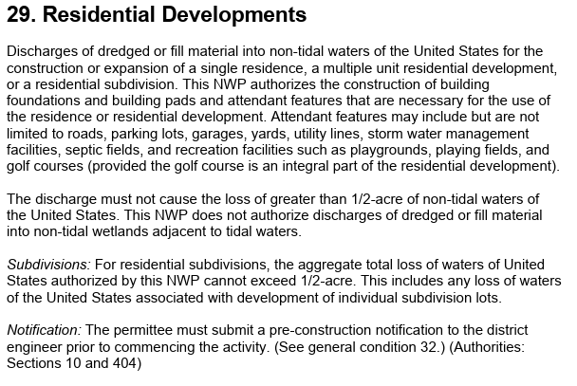
21 Nationwide Permits require a PCN for all activities.
Notes:
This is Nationwide Permit 29, Residential Developments. A little bit more complicated of a permit than Nationwide Permit 1. But you’ll see it has that “Notification” section at the end. This is an example of a Nationwide Permit that requires notification for every single proposed activity. There’s no possibility of using this Nationwide Permit without first obtaining a verification letter from the Corps.

Slide 24
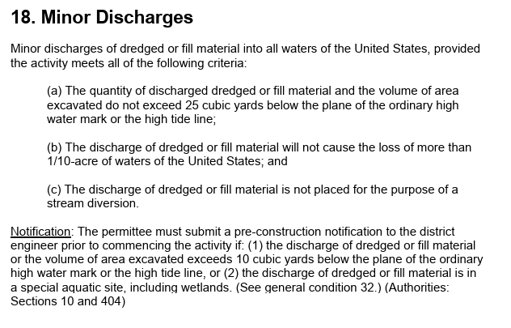
16 Nationwide Permits require a PCN for some activities.
Notes:
And lastly, this is Nationwide Permit 18, Minor Discharges. Here you’ll see that the notification thresholds are a little bit more complicated than the other examples. For this Nationwide Permit, notification is required if the volume of fill or excavation exceeds 10 cubic yards below the ordinary high water mark or high tide line, OR if the discharge of fill or dredged material would be within a special aquatic site. So, if a project doesn’t meet or exceed either of those thresholds, notification isn’t required. But if either of those thresholds are met or exceeded, notification is required, and the project cannot be completed until the applicant receives a verification letter from the Corps.
Under this Nationwide Permit, specifically, if an applicant proposes to discharge less than 10 cubic yards of fill material below the high tide line or ordinary high water mark, and that area is not a special aquatic site, a preconstruction notification is not required. If they propose to discharge more than 10 cubic yards, up to the 25 cubic yards authorized by this Nationwide Permit, a preconstruction notification is required.

Slide 25
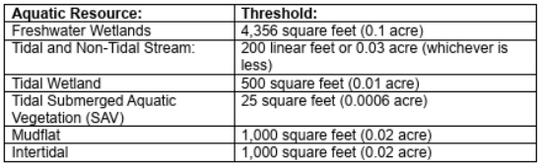
Nationwide Permit notification triggers
Nationwide Permit General Conditions and Regional Conditions can also “trigger” notification
  General Condition 16, Wild and Scenic Rivers
  General Condition 18, Endangered Species
  General Condition 20, Historic Properties
    Proposed Regional Condition A
      Additional PCN Requirement (Specific Resources): A PCN is required for any proposed activities which would result in the permanent loss of waters of the U.S. at or above the listed thresholds to the following aquatic resources:
EXAMPLE
Notes:
These are examples of conditions which trigger a PCN regardless of whether the Nationwide Permit is non-notifying. So, for example, if an activity is proposed to occur within a Wild and Scenic River, a PCN is required.
And this is our proposed Regional Condition A, which triggers a PCN for specific aquatic resources at certain sizes of impacts.
There are many more proposed Regional Conditions which would trigger a PCN, this one is just illustrative of the concept.

Slide 26
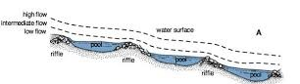
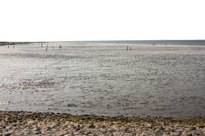
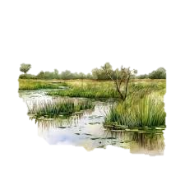

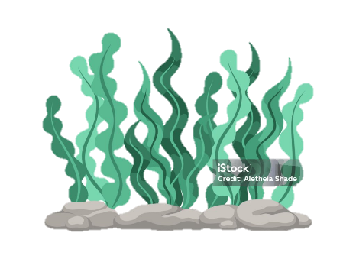
Comparison of NWP and RGP impact thresholds
Many Discharges of Fill or Dredge Material in the following:
Riffle & Pool Complexes
Sanctuaries
& Refuges
Mudflats
Wetlands
Coral Reefs Vegetated Shallows
Require a Pre-Construction Notification under the NWPs
Notes:
One important distinction about the Nationwide Permits is that they always require a preconstruction notification if the proposed activity involves a discharge of fill or dredged material into a special aquatic site. Special aquatic sites are defined in our joint regulations with the EPA, the Section 404(b)(1) Guidelines, and are Sanctuaries and Refuges, Riffle and Pool Complexes, Mudflats, Coral Reefs, Vegetated Shallows, and, of course, wetlands.

Slide 27
Comparison of nwp and RGP impact thresholds
Up to 1 acre of impacts to waters
Includes permanent, temporary, and secondary impacts
Up to 0.5 acre of loss of waters*
Temporary impacts not included in threshold
Regional General Permits
Nationwide Permits
*Waters of the U.S. that are permanently adversely affected by filling, flooding, excavation, or drainage because of the regulated activity.
Notes:
Okay, so the next overarching difference between the Nationwide Permits and the Regional General Permits are the impacts thresholds. Our Regional General Permits typically authorize up to one acre of impacts to waters, and this includes all permanent, temporary, and secondary impacts.
The Nationwide Permits, on the other hand, typically only authorize up to half an acre of loss of waters. The phrase “loss of waters” is defined in the Nationwide Permit program as part of the final rule when the Nationwide Permits are issued every five years. It is defined as: Waters of the U.S. that are permanently adversely affected by filling, flooding, excavation, or drainage because of the regulated activity. Waters of the United States that temporarily filled, flooded, excavated, or drained, but restored to pre-construction contours and elevations after construction, are not included in the measurement of loss of waters of the United States.
(do not read to audience) Full definition from Final NWP Rule:
Waters of the United States that are
permanently adversely affected by
filling, flooding, excavation, or drainage
because of the regulated activity. The
loss of stream bed includes the acres of
stream bed that are permanently
adversely affected by filling or
excavation because of the regulated
activity. Permanent adverse effects
include permanent discharges of
dredged or fill material that change an
aquatic area to dry land, increase the
bottom elevation of a waterbody, or
change the use of a waterbody. The
acreage of loss of waters of the United
States is a threshold measurement of the
impact to jurisdictional waters or
wetlands for determining whether a
project may qualify for an NWP; it is not
a net threshold that is calculated after
considering compensatory mitigation
that may be used to offset losses of
aquatic functions and services. Waters
of the United States temporarily filled,
flooded, excavated, or drained, but
restored to pre-construction contours
and elevations after construction, are
not included in the measurement of loss
of waters of the United States. Impacts
resulting from activities that do not
require Department of the Army
authorization, such as activities eligible
for exemptions under section 404(f) of
the Clean Water Act, are not considered
when calculating the loss of waters of
the United States.

Slide 28
2022 and 2025 ri Rgp comparison
2022 RI GP
2025 RI GP
SELF VERIFICATION (SV)
SVNF form and verification letter from USACE
Possible to self-verify with only a CRMC permit using Programmatic General Permits (PGP)
PRE CONSTRUCTION NOTIFICATION (PCN)
Relied on state public notices and required extended USACE outreach to obtain the federally required information, extending our timeline for verification
INDIVIDUAL PERMIT APPLICATION
  Required IP application and written verification from USACE (does not change in 2025)
SELF VERIFICATION (SV)
  No form or notification to USACE needed for self-verification (SV) (same as NWP "non-notifying")
  PGPs rescinded in 2025, thus PCN submissions required for ALL projects not meeting SV
  Applicant reviews all thresholds, terms and general conditions of GP
  Applicant performs coordination for ESA, Essential Fish Habitat (EFH), and S106 for their records
  PCN requirement is triggered if the activity exceeds SV criteria doesn’t meet general conditions
PCN SUBMISSION
  This is not a huge lift or a big change from your state applications!
  (Requirements on next slide)
Notes:
Hello everyone and thank you for joining us today!
So, the new 2025 RI General Permit will be issued within the next month (July/August 2025)
This will replace the 2022 GP and is a transition until NWPs are issued in March 2026
Changes from 2022 to 2025 GPs include less interaction with USACE for self-verifications and we now require separate PCN submissions from the state for projects that don’t meet SV
I’ll review the PCN submission requirements on the next slide

Slide 29
2025 ri gp PCN SUBMISSION CONTENT
Submit PCN using RRS or RI Inbox: cenae-r-ri@usace.army.mil
  Applicant signed ENG 4345 form
  Mapper results and evidence of coordination for ESA (IPaC and NMFS mappers), EFH, and S106 (if any resulted from SV coordination).
  Plans with federal jurisdictional lines (MHW, MLW, HTL, OHWM and flagged wetland boundaries)
  Narrative description of project with federally calculated impacts (this differs from state jurisdiction)
  Additional information is required for some specific GPs
PCN submission /IP application procedures established now will not change when we issue NWPs!
Notes:
PCN submission requirements are not a big change from what we require now, there is a simple two page form, some resource mapper results and
Project plans, narrative description and calculated impacts using our federal jurisdictional areas which differ from state calculations.
Additional information is required for some specific GPs, like GP 4 for docks, which some of you are familiar with.
However, the process and requirements established now under the 2025 GPs are not going to change when we issue the NWPs.

Slide 30
march 2026 transition from 2025 rgp to nwp
If you have an existing verification – you do not need another when we issue NWPs!
RI GP expiration dates:
  RI 2022 – Verifications expire May 2027
  RI 2025 – Verifications expire July/Aug 2030
After March 2026, we will be utilizing NWPs to process new PCN submissions
Notes:
So, when we issue the NWPs in March of 2026, if you have an existing verification – you do not need another one.
Verifications under the current GP remain valid until the expiration of the general permit, or one year from the date of expiration if the project has commenced or is under contract
After March 2026, we will be utilizing NWPs to process new PCN submissions

Slide 31
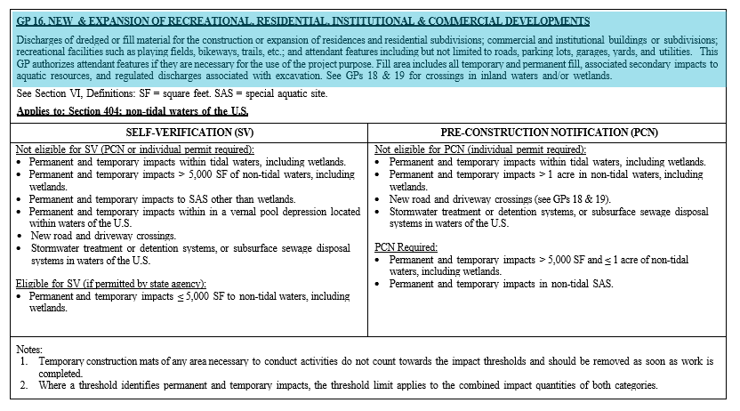
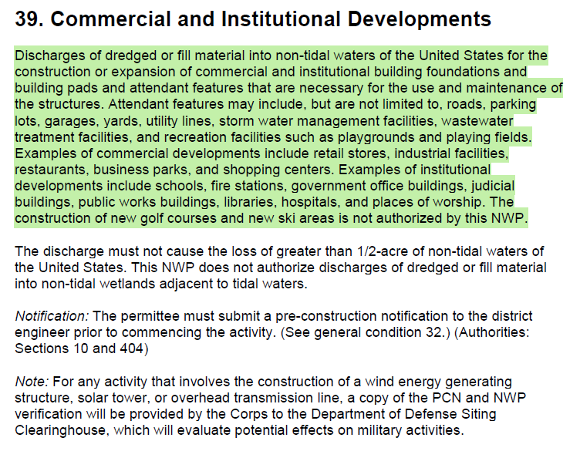
Comparison of Rgp and Nwp descriptions
RI Regional General Permit 16
Nationwide Permit 39
Notes:
I know the text is tiny on this slide but it’s not important, and I show it larger on the next slide.
What I want you to notice here is the visual difference between how the RGP descriptions look now, which is what you’re familiar with (on the left)
and how NWP descriptions will look (on the right)

Slide 32
Comparison of RI RGP 16 and NWP 39
Rhode Island RGP 16, New and Expansion of Recreational, Residential, Institutional, and Commercial Developments
NWP 39, Commercial and Institutional Developments
Discharges of dredged or fill material…for the construction or expansion of commercial and institutional building foundations and attendant features.
Discharges of dredged or fill material for the construction or expansion of…commercial and institutional buildings or subdivisions.
This GP authorizes attendant features if they are necessary for the use of the project purpose.
Attendant features that are necessary for the use and maintenance of the structures.
Attendant features may include, but are not limited to, roads, parking lots, garages, yards, utility lines, storm water management facilities, wastewater treatment facilities.
Attendant features including but not limited to roads, parking lots, garages, yards, and utilities.
Recreational facilities such as playing fields, bikeways, trails, etc.
Recreational facilities such as playgrounds and playing fields.
Notes:
Here are the same permit descriptions I showed in the previous slide for GP 16 on the left and the nearly identical description of NWP 39 on the right for commercial and institutional developments
Obviously, some other activity comparisons are not going to be as straightforward and will more complex, but most descriptions remain the same as they were based on NWPs.
The difference to note here is that Nationwides separate residential projects into their own category and separate permit, and aren’t grouped together with other development projects like the existing GP

Slide 33
Comparison of RI rGP 16 and NWP 39
 | Overall GP Limits (IP required if exceeded) | PCN Threshold | Applicable Waters
RI RGP 16, New and expansion of recreational, residential, institutional, and commercial developments | 1 acre of non-tidal waters | • Permanent and temporary impacts ≤1 acre but > 5,000 square feet • Impacts to non-tidal SAS | Non-tidal WOTUS
NWP 39, Commercial and Institutional Developments | 1/2-acre loss of non-tidal waters | Required for all projects (no "non-notifying") | Non-tidal WOTUS
Notes:
This comparison slide shows the same permit comparison with the limits, thresholds, and waters that they apply to.
This displays the simplification of thresholds with Nationwides, stating plainly, a PCN submission is required for all projects
The biggest change from GPs to NWPs is that limits have been reduced for projects have the potential for higher environmental impacts, like larger development projects, that require a higher level of evaluation

Slide 34
RHODE ISLAND
Regional General permits and nwps
Notes:
This is just a handy chart comparison showing the RI GP numbers and activities and their corresponding NWP numbers. You can access this when we post the presentation online following the meeting.
Thank you for your time.
I’m going to pass the presentation back to Birdie now for a brief explanation of our new online Regulatory Request System

Slide 35

Regulatory Request System
(Application process)
Use of the Regulatory Request System is highly encouraged!
Eliminate the need for paper applications and mailing.
Automated data checks to ensure completed and accurate submissions.
Real-time communication and user-friendly dashboard.
Providing on-line access to all relevant Regulatory information.
Providing the ability to create a draft request, download it, and share it with your organization and clients, and revisit it later to finish it.
Notes:
Okay, so we’ve gone over a lot of information so far about the Nationwide Permits and how they are similar and different from the Regional General Permits. Another thing that will be similar is the application process. Some of you may already be familiar with our Regulatory Request System, or RRS. We highly encourage applicants to submit preconstruction notifications through our RRS.
Submitting your application through this system helps ensure timely receipt and entry into our system, which means you’ll be assigned a Project Manager more quickly. Additional benefits include:
Elimination of paper applications and mailing requirements.
Automated data checks that help ensure complete and accurate submissions.
Real-time communication and a user-friendly dashboard to reduce delays and unnecessary follow-ups.
Centralized access to all relevant Regulatory information.
The ability to save draft requests, share them with colleagues or clients, and return to complete them later.
Reduced internal data entry so Project Managers can focus more on project reviews.
A responsive and interactive Help Desk for real-time assistance and troubleshooting.

Slide 36
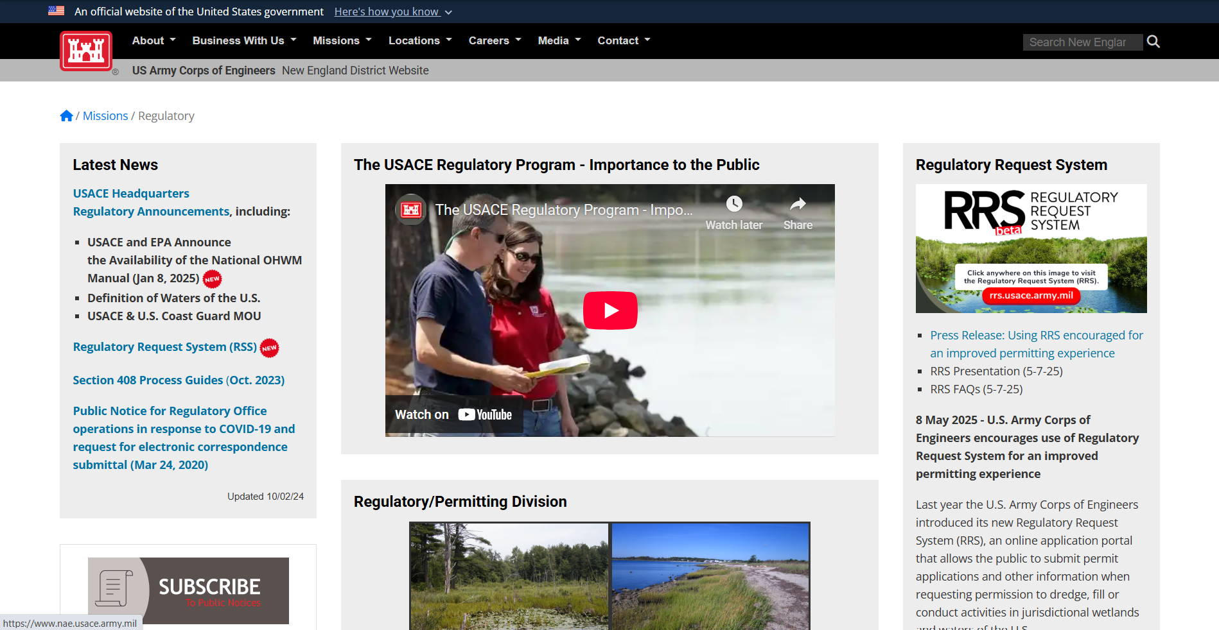
Regulatory Request System
Notes:
You can find a link to RRS on our New England District Regulatory Website in the upper right hand corner.

Slide 37


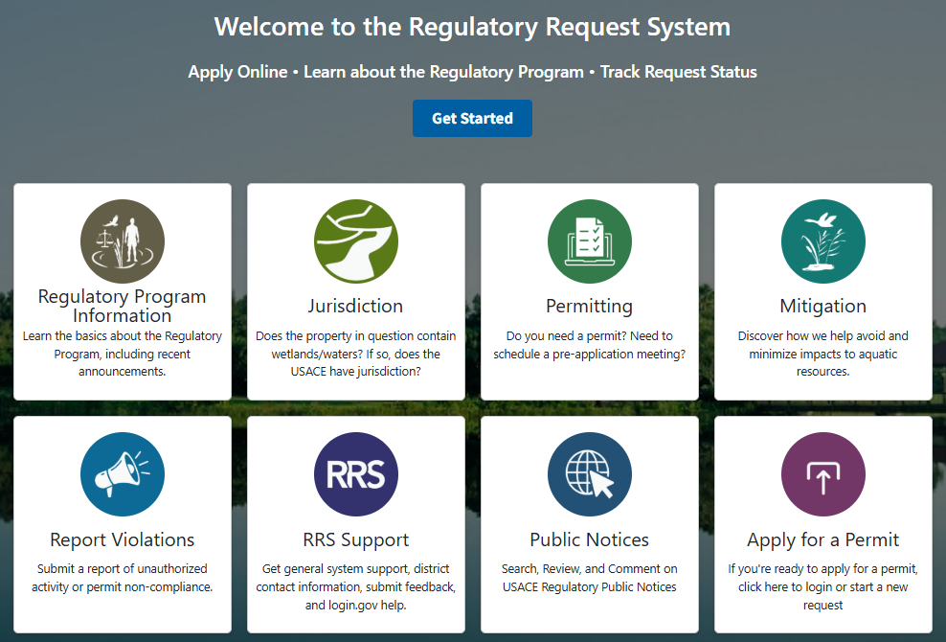
Regulatory Request
System
Notes:
That link will bring you to this page. Here you can click on any of those top four boxes to learn about different aspects of our Regulatory Program.
There’s help when you click the RRS Support box, and you can report potential violations, view and comment on public notices, and apply for permits and verifications all through RRS.

Slide 38
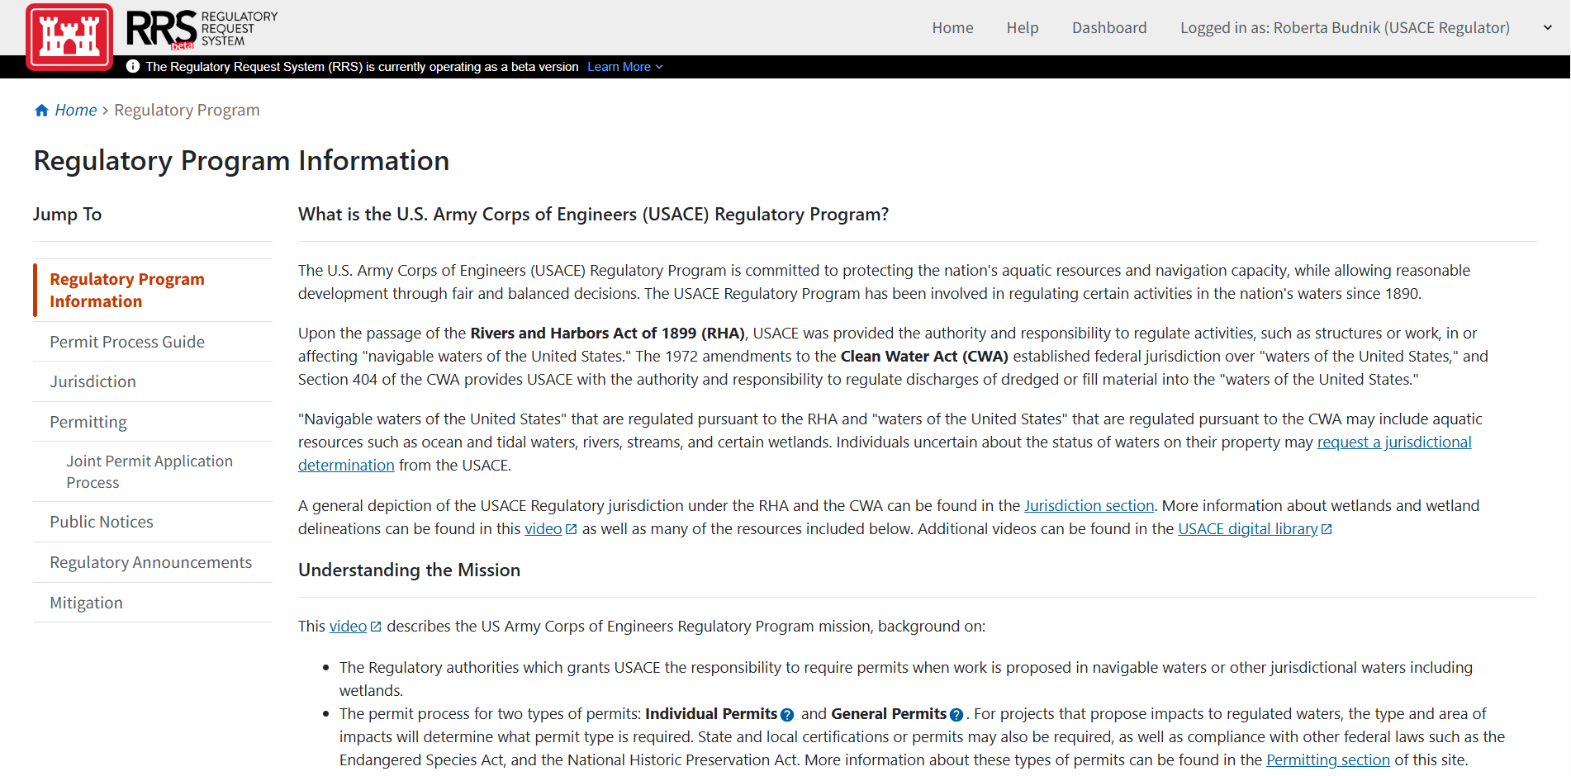
Regulatory request system
Notes:
When you click any of the boxes on that RRS home page, there will be a navigation menu on the left side of the screen, so you don’t have to keep going back to that home page to get to your next topic of interest.

Slide 39

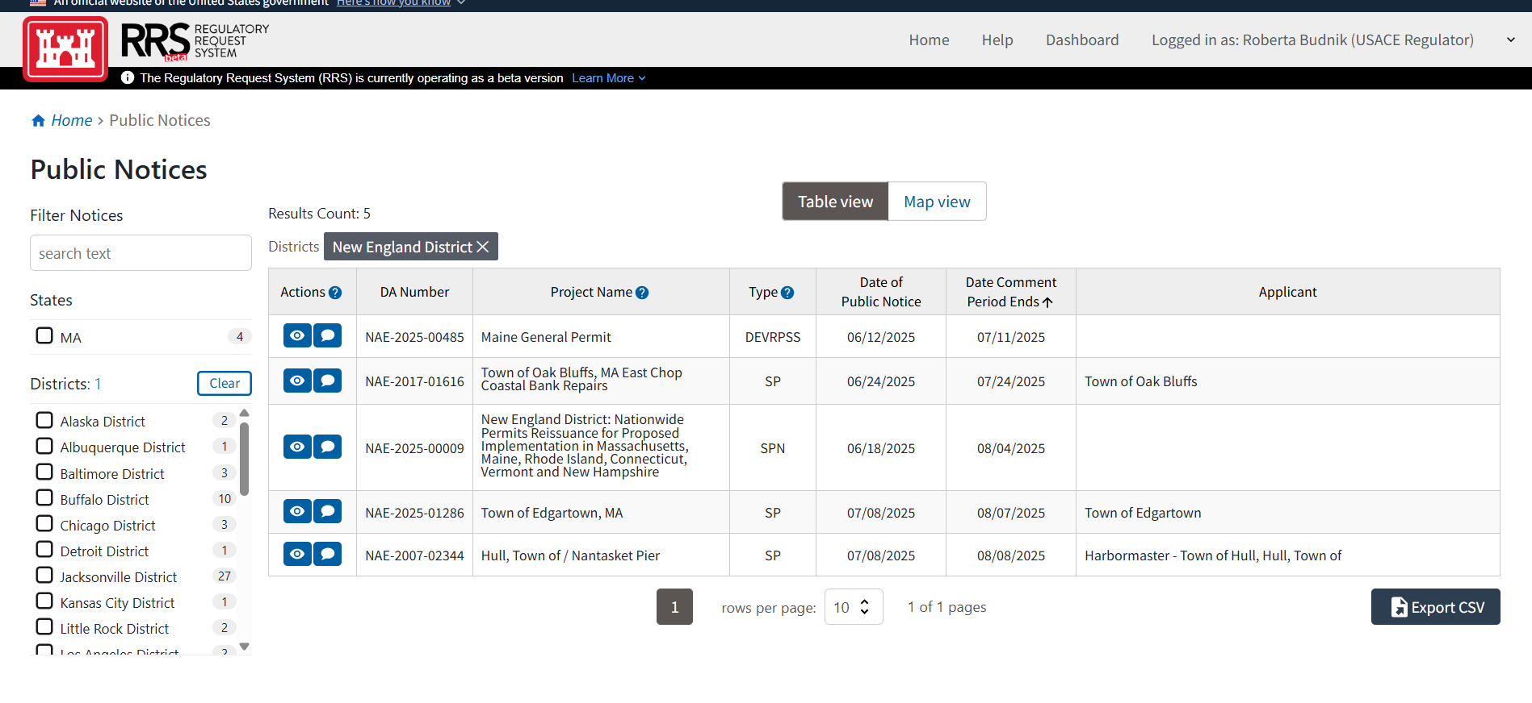
Regulatory Request System
Notes:
This is just an example of what RRS looks like when you want to view and comment on public notices. You can search by district and/or state on the left hand side and it will pull up any active public notices for that state or district.
In this example, I filtered by New England District, and you can see our public notice for the Nationwide Permits and proposed Regional Conditions on the list. This is another way for you to provide comments to us on our proposed Regional Conditions. Scanning that QR code will take you directly to the RRS public notices page, but you will still need to filter by New England District. This is a fairly new capability of the RRS that we are super excited about.

Slide 40
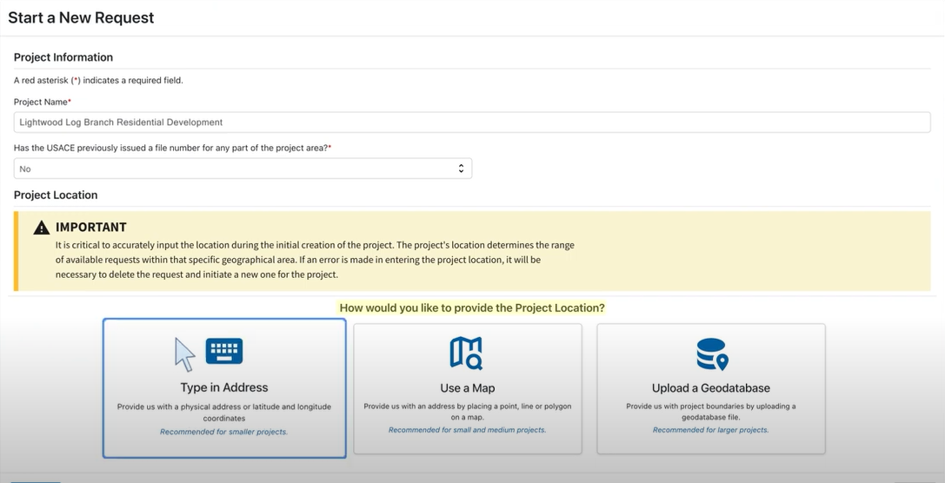
Regulatory Request System
Notes:
And this here is just an example of what it looks like when you start a new request. There are instructional videos in the RRS Support page that you can watch that takes you through the process, but the system will ask for all of the necessary information needed.

Slide 41
PCN Screening tool
Tool being constructed into the RRS to help the public “self-regulate” with non-notifying general permits
Screens proposed activity against known PCN criteria and indicates to applicant whether a PCN is required
Preliminarily screens for Federal law compliance and the need for any required consultations, such as ESA, 106, Essential Fish Habitat, Wild and Scenic Rivers, Section 408, CWA Sec. 401, CZMA
If proposed activity passes screening without triggering PCN, RRS will auto-generate a letter for permittee
May have “no permit required” functionality for non-regulated & exempt activities
BETA tool version under construction, will be available in RRS in upcoming months (2025)
Notes:
Another upcoming capability of the RRS that we are excited about is the Pre-Screening Tool.
This tool is being developed for the nation and will help the public “self-regulate” with non-notifying general permits. The goal is for an applicant to answer questions about their proposed activity, and the tool will screen again known PCN thresholds and then tell the applicant whether they need to submit a PCN to the Corps or not.
If a PCN is not required, the RRS will generate a letter stating such for the permittee. The tool may also be able to generate “no permit required” letters for non-regulated and exempted activities.
A BETA version of this tool should be available in the upcoming months.

Slide 42

Complete preconstruction notifications
Nationwide Permit General Condition 32 outlines the information required for a complete preconstruction notification, including:
  A written description of the proposed activity
        Purpose
        Direct and indirect adverse environmental effects of the activity
        Anticipated loss of waters of the U.S. in acres or linear feet
  Written description of mitigation measures, including a statement of how compensatory mitigation requirements will be satisfied
  Project plans
    Delineation of wetlands and any other waters on the project site
  Names of threatened or endangered species or designated critical habitat that may be affected
  Statement of any historic properties which might have the potential to be affected
Notes:
Although RRS will help applicant submit complete preconstruction notifications, we do want to point out that Nationwide Permit General Condition 32 spells out in detail what’s required for a complete PCN. It is pretty common that Corp project managers need some additional information to consider a PCN complete, however. Some of the missing information that we more commonly see and have to request is project purpose, description of the direct and indirect impacts of the project, including temporary impacts. Many times, we need more complete mitigation statements – that is statements describing avoidance and minimization of impacts to waters and proposed compensatory mitigation for unavoidable impacts. Adequate project plans, delineation of wetlands and waters on the project site, and information on endangered species and historic properties.
Nationwide Permit General Condition 32 outlines the information required for a complete preconstruction notification:
Applicant name, address, and telephone number
Location of the proposed activity
Identification of the Nationwide Permit the applicant wants to use
A written description of the proposed activity
Purpose
Direct and indirect adverse environmental effects of the activity
Anticipated loss of waters of the U.S. in acres or linear feet
Written description of mitigation measures, including a statement of how compensatory mitigation requirements will be satisfied
Project plans
Delineation of wetlands and any other waters on the project site
Identification of the Wild or Scenic River or “study river,” if applicable
Statement confirming request of Section 408 permission from the Corps, if applicable
Names of threatened or endangered species or designated critical habitat that may be affected
Statement of any historic properties which might have the potential to be affected

Slide 43
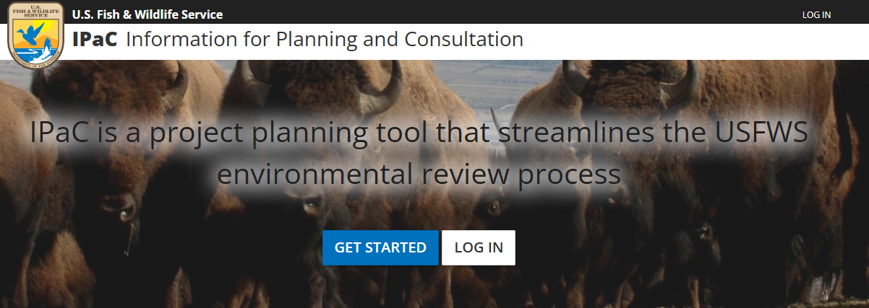
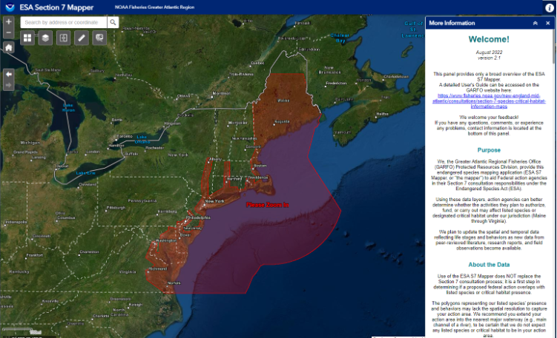
Endangered species act
USFWS Species:
Information for Planning and Consultation (IPaC): https://ipac.ecosphere.fws.gov/
NMFS Species:
ESA S7 Mapper: https://noaa.maps.arcgis.com/apps/webappviewer/index.html?id=a85c0313b68b44e0927b51928271422a
Notes:
It really helps Corps project managers out if applicants screen their projects for potential endangered species or designated critical habitat impacts. This helps us process preconstruction notifications more efficiently. The U.S. Fish and Wildlife Service and National Marine Fisheries Service have really great tools online that can help with that.
National Marine Fisheries Service has a mapper that shows the range of endangered species under their jurisdiction, and you can go online, zoom to your project area and print a report of the species and/or designated critical habitat that may be present.

Slide 44

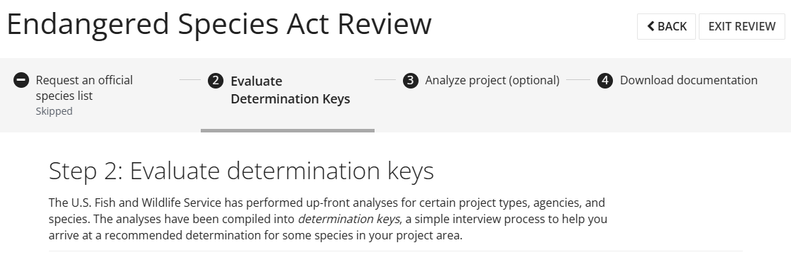
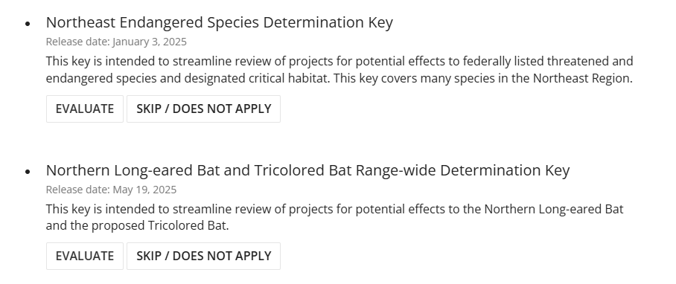
Endangered species act
Applicants encouraged to use the Dkeys and submit the results with their PCN.
If no other ESA listed species are present, and a determination of “no effect” is reached, a PCN is not triggered by ESA.
Notes:
The U.S. Fish and Wildlife Service has taken their tool a little bit further. In their “Information for Planning and Consultation or IPaC tool, they have determination keys or Dkeys that can be completed for certain species. Applicants are encouraged to utilize this tool to first determine which species may be present in their project area and then complete the applicable Dkeys for those species, if available. If a “no effect” or “not likely to adversely affect” determination is reached in the Dkey, a PCN isn’t triggered by Endangered Species resources. That is not to say a PCN isn’t required – a PCN may still be required by the terms of the Nationwide Permit itself or another General or Regional Condition. Results of those Dkeys should be included with a PCN submittal to the Corps.

Slide 45
National historic preservation act Section 106—nationwide permits
General Condition 20. Historic Properties
(a) - (e)
(a) No activity is authorized under any NWP which may have the potential to cause effects on properties listed, or eligible for listing, in the National Register of Historic Places (NRHP) until the requirements of Section 106 of NHPA have been satisfied.
(b) Federal permittees should follow their own procedures for complying with requirements of Section 106 of the NHPA.
If PCN is required for the proposed NWP activity, federal permittee must provide appropriate documentation demonstrating compliance with the requirements. The respective federal agency is responsible for fulfilling its obligation to comply with Section 106.
Notes:
DISCUSSION: similarities with existing state GP process (e.g., outreach to SHPO/THPO/NRHP for info on historic properties) and differences (e.g., if no historic properties, and no potential, no PCN required and prospective permittee is pre-authorized if meets NWP thresholds i.e. no more than minimal adverse environmental impacts, no requirement to submit info).

Slide 46
National historic preservation act Section 106—nationwide permits
General Condition 20. Historic Properties—cont.
(c ) Non-federal permittees must submit a PCN if the NWP activity might have the potential to cause effects on historic properties, include information on which properties, map, or potential presence of properties.
Assistance for information on historic properties can be sought from SHPO, THPO, & NRHP.
District Engineer reasonable and good faith effort to identify historic properties commensurate with potential impacts, and with PCN information, determine if NWP activity has potential to cause effects to historic properties.
If no potential to cause effects (36 CFR 800.3(a)), no consultation. If activity has potential to cause effects to historic properties, consultation with consulting parties (as identified at 36 CFR 800.2(c)).
Notes:
DISCUSSION: similarities with existing state GP process (e.g., outreach to SHPO/THPO/NRHP for info on historic properties) and differences (e.g., if no historic properties, and no potential, no PCN required and prospective permittee is pre-authorized if meets NWP thresholds i.e. no more than minimal adverse environmental impacts, no requirement to submit info).

Slide 47
National historic preservation act Section 106—nationwide permits
General Condition 20. Historic Properties—cont.
(d) If historic properties are identified or NWP activity may cause effects, applicant cannot begin the activity until notified that activity has no potential to cause effects to historic properties or the NHPA Section 106 consultation is complete. Upon receipt of complete PCN, notify the prospective permittee within 45 days whether NHPA Section 106 consultation is required.
(e) Prospective permittee should be aware of Section 110k of the NHPA, prevents the Corps from granting a permit or assistance to applicant who intentionally avoids Section 106 requirements, intentionally significantly adversely affected an historic property (to which the permit relates), or having legal power to prevent it allowed significant adverse effect to occur. Corps may consult with the ACHP, and if circumstances justify Corps granting assistance despite adverse effect, Corps notifies the ACHP, providing required documentation.
Notes:
DISCUSSION: similarities with existing state GP process (e.g., outreach to SHPO/THPO/NRHP for info on historic properties) and differences (e.g., if no historic properties, and no potential, no PCN required and prospective permittee is pre-authorized if meets NWP thresholds i.e. no more than minimal adverse environmental impacts, no requirement to submit info).

Slide 48
National historic preservation act—nationwide permits
General Condition 21. Discovery of Previously Unknown Remains and Artifacts
Permittees that discover previously unknown historic, cultural, or archaeological deposits or artifacts while accomplishing the authorized activity must immediately notify the DE of what was found, and to avoid construction activities in the location until any required coordination is completed.
DE will initiate federal, tribal, state coordination, as appropriate, to determine if recovery is warranted or if site is eligible for listing in NRHP.
General Condition 17. Tribal Rights
No activity or its operation may impair reserved tribal rights, including, but not limited to, reserved water rights and treaty fishing and hunting rights.
tribal rights—nationwide permits
Notes:
DISCUSSION: GC21 very similar/same as existing state GP language.
GC17 very similar/same as existing state GP language.

Slide 49
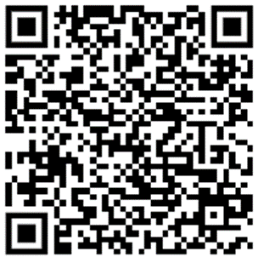

Questions?
CENAE-R-NWP@USACE.ARMY.MIL
REMINDERS:
Federal Register NWP Comment Period Ends: July 18, 2025
Proposed Regional Conditions Comment Period Ends: August 4, 2025

Slide 50
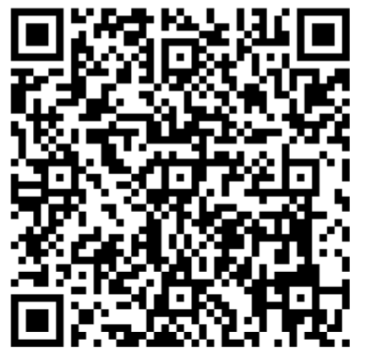
Feedback survey
Please provide feedback from today so we can plan for the next event. Your feedback is very important to us!
Please scan the QR Code below and complete the survey.
Thank you!

